Slide 1

SBEG108 NUMERICAL METHODS IN BME
Stem Cell Differentiation
Numerical and Machine Learning Methods for Differential Equations in Biomedical Engineering
Team 4 Course Project

Slide 2

SBEG108 NUMERICAL METHODS IN BME
1.
Overview of the Stem Cells Differentiation
2.
Explanation of the ODE model
3.
Numerical and Learning-based solution steps
4.
TABLE OF CONTENT
Results of Solutions
5.
Future Work and Improvements

Slide 3


SBEG108 NUMERICAL METHODS IN BME
Overview of the Stem Cells Differentiation
What is Stem Cell Differentiation?
Why PU.1 and GATA-1?
How to use ODE to study this?

Slide 4
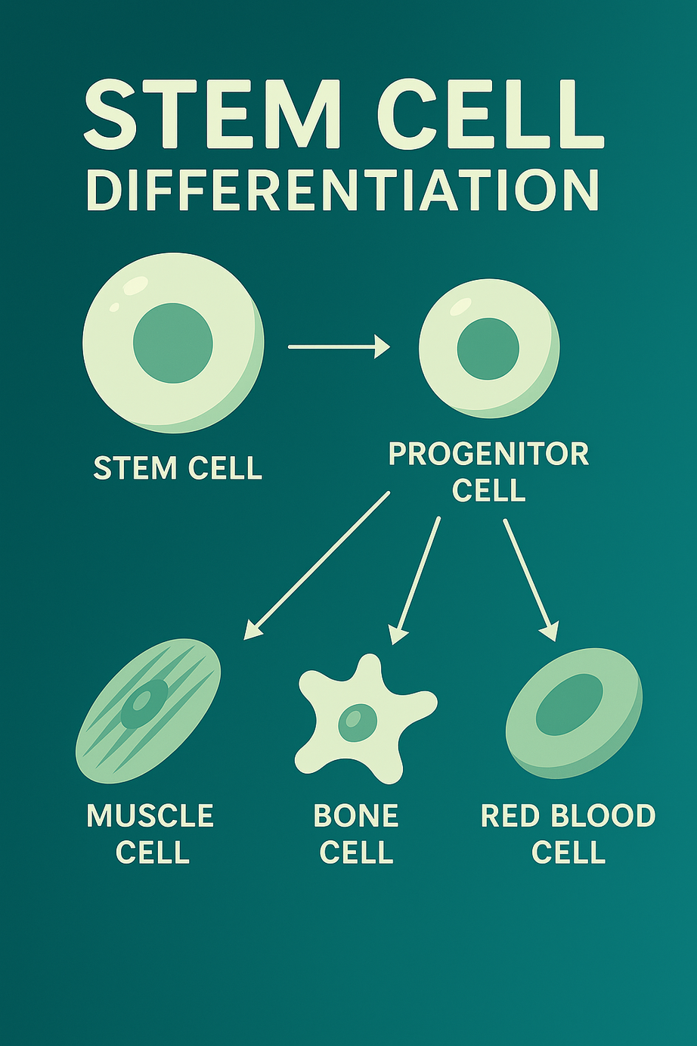
SBEG108 NUMERICAL METHODS IN BME
What is Stem Cell Differentiation?
Stem cells can divide and transform into specialized cells like muscle or bone.
The process:
Stem cell → Progenitor state → Specialized cell
Why PU.1 and GATA-1?
These two key transcription factors control blood cell development.
Both are low in early progenitors, but their interaction decides the final cell type.
Understanding them helps in:
→ Directing cell fate → Advancing therapies

Slide 5

To model this interaction, we use a 2×2 nonlinear ODE system:
SBEG108 NUMERICAL METHODS IN BME
→ Two equations → Two unknowns (PU.1 and GATA-1 concentrations)
The system tracks how these two transcription factors change over time.
To analyze the model, we use:
How to use ODE to study this?
→ Numerical solvers → Machine learning methods

Slide 6
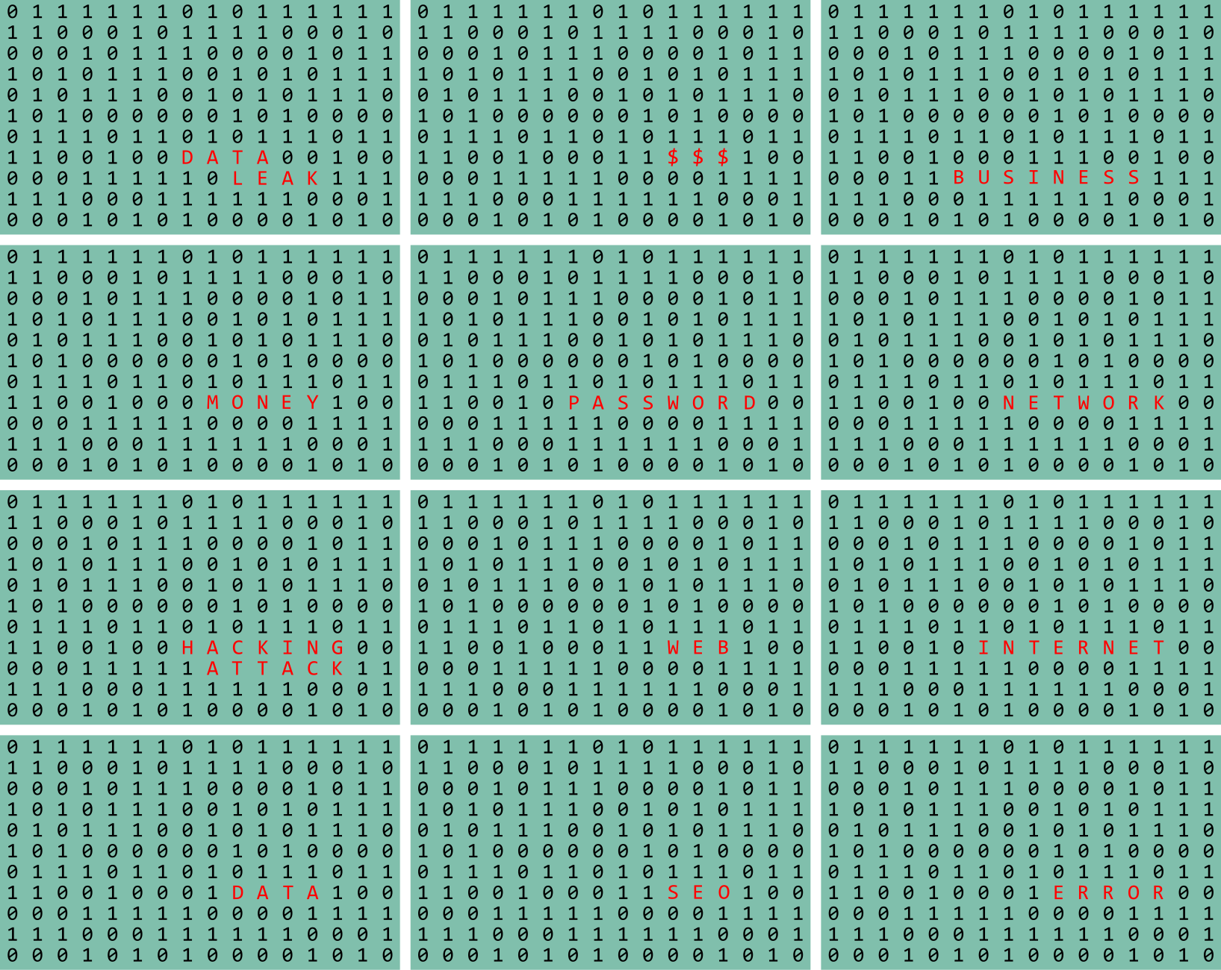
SBEG108 NUMERICAL METHODS IN BME
Explanation of the ODE Model

Slide 7

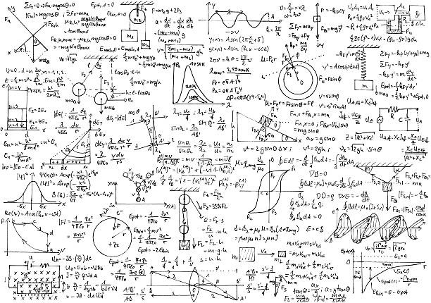
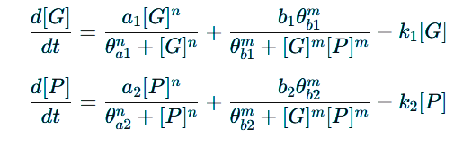
SBEG108 NUMERICAL METHODS IN BME
Overview of the ODE Model
Variables:
[G], [P] : Normalized expression levels of GATA-1 and PU.1
t: Time
a₁, a₂: Self-activation rates
b₁, b₂: Cross-inhibition influence on basal activation
θa₁, θa₂, θb₁, θb₂: Thresholds of activation/inhibition
k₁, k₂: Degradation rates
n, m: Hill coefficients (control response sharpness)

Slide 8
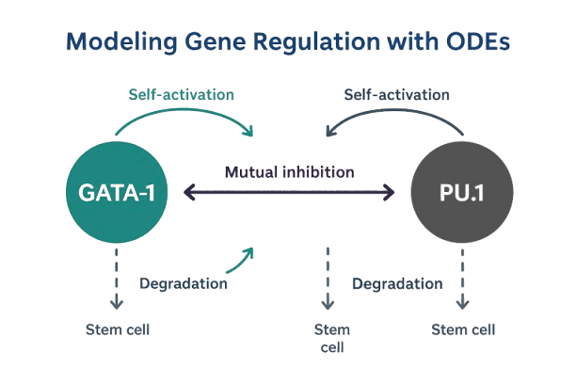
SBEG108 NUMERICAL METHODS IN BME
Each ODE consists of three biologically significant components:
Self-activation: Each gene boosts its own expression.
Mutual inhibition: GATA-1 and PU.1 suppress each other.
Degradation: Natural decay of gene expression over time.
The system can settle into one of two stable gene expression states.
GATA-1 dominance → Erythroid cells (e.g., red blood cells)
PU.1 dominance → Myeloid cells (e.g., macrophages)

Slide 9
SBEG108 NUMERICAL METHODS IN BME
Numerical and Learning-based solution steps

Slide 10


LSODES
What is LSODES?
LSODES (Livermore Solver for ODEs with Sparse Matrices) is an implicit, adaptive step size solver based on Backward Differentiation Formulas (BDF) an implicit method for (stiff systems) , and Adams-Bashforth an explicit method for ( non-stiff systems), offering strong stability for stiff problems. The simplest BDF is the Backward Euler method which is also called BDF1 (1st-order BDF , and it’s formula :
Numerical
Solution

Slide 11



Work Flow
SBEG108 NUMERICAL METHODS IN BME
1.DEFINE THE ODE SYSTEM
3.RUN THE SOLVER (LSODES)
Create a custom function like (stem_1) to describe the system of differential equations governing the behavior of variables like G(t) and P(t).
Use the lsodes() function from the deSolve package in R to integrate the system over the desired time interval.
This solver is particularly suited for stiff systems with sparse Jacobians.
2.INITIALIZE PARAMETERS AND INITIAL CONDITIONS
Set model parameters and initial values:
G(0)=1 , P(0)=1
Example parameters: n=4 , m=1

Slide 12
TRAPEZOIDAL
What is TRAPEZOIDAL ?
To improve accuracy over the basic Euler method, we implemented the trapezoidal rule for solving the nonlinear ODE system. The Euler approximation:
Numerical
Solution
is replaced by the more accurate trapezoidal rule:
which is implicit in yn+1 and requires fixed-point iteration at
each time step.
SBEG108 NUMERICAL METHODS IN BME

Slide 13

Work Flow
SBEG108 NUMERICAL METHODS IN BME
1.INITIALIZE
3.APPLY FIXED-POINT ITERATION
Set convergence tolerance 10-6
Set number of steps 200
Set maximum iterations per step (100)
1-Evaluate:
2-Compute:
2.INITIAL GUESS
3- Check:
:
predict yn+1 using Euler’s method :
IF
stop iteration.
Else, set yguess=ynext​ and repeat.

Slide 14

Work Flow
SBEG108 NUMERICAL METHODS IN BME
4.UPDATE SOLUTION AND TIME
Update: Set yn+1 = ynext, increment t, and continue to
Final time.
FIN
ALLY
5.RECORD PERFORMANCE METRICS
Measure excution time.
Calculate accuracy.

Slide 15
SBEG108 NUMERICAL METHODS IN BME
What is RADAU?
RADAU
The Radau method is a type of implicit Runge-Kutta method designed specifically for stiff ODE systems.
It is particularly effective when
The system has nonlinear terms like Gn , Gm , Pm , and
Parameters such as k1,k2,... operating on very different time scales.
Numerical
Solution
Radau allows:
Stable integration with relatively large time steps,
High accuracy, and
Built-in error control and step-size adaptation.

Slide 16

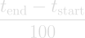

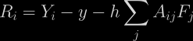
Work Flow
SBEG108 NUMERICAL METHODS IN BME
1.INITIALIZE
2.INITIAL GUESS
Choose the initial time step h:
Set tolerance to 10 (-8)
Max iterations per step: 50
For 3-stage Radau method:
Y1=Y2=Y3=yn
If no t_eval
If t_eval is used
3.PERFORM NEWTON ITERATION AT EACH STEP
1-Evaluate :
2-Compute residuals and the Jacobian matrix
3-Solve the linear system to update Yi , and iterate until convergence
COMPUTE RESIDUALS

Slide 17
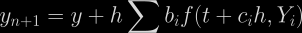

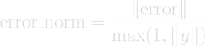
Work Flow
SBEG108 NUMERICAL METHODS IN BME
4. UPDATE the Solution
6.REPEAT!
Continue integration until reaching final time t=5.
FIN
ALLY
5.ESTIMATE ERROR AND CONTROL STEP SIZE
7.RECORD PERFORMANCE METRICS
Count number of function calls (ncalls).
Measure total computation time.

Slide 18
PINNS
Physics-Informed Neural Networks
are deep learning models that integrate physical laws (like ODEs or PDEs) into their training. Instead of learning only from data, PINNs also minimize how much they violate known physics, ensuring the model fits both the data and the governing equations.
Learning
Key Features
-Based
Physics-based Loss: The loss function includes terms that penalize violations of the governing equations (e.g., ODE or PDE residuals) and initial/boundary conditions.
Generalization: By enforcing physical laws, PINNs can generalize better, even with limited data.
Automatic Differentiation: PINNs leverage frameworks like PyTorch or TensorFlow to compute derivatives needed for the physics loss using automatic differentiation.
Solution
case 1

Slide 19


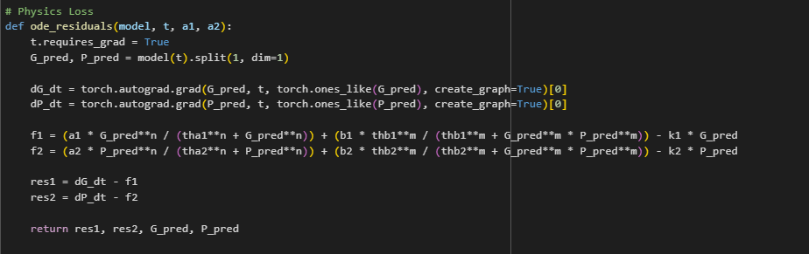
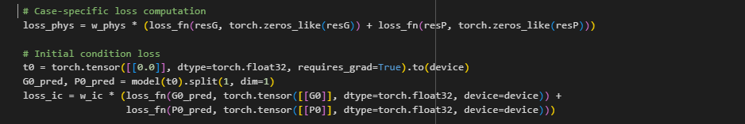
SBEG108 NUMERICAL METHODS IN BME
LOSS COMPUTATION:
The PINN computes its loss as the sum of two main parts:
Physics loss: Measures how well the model satisfies the ODE by penalizing residuals using automatic differentiation and MSE.
Initial condition loss:
Initial condition loss: Ensures the model's predictions match known initial values using mean squared error.

Slide 20
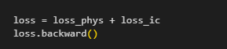


LOSS COMPUTATION:
The model is trained by:
Forward Pass: Predict values across all time points using the neural network.
Loss Calculation: Compute total loss = physics loss + initial condition loss.
Backward Pass: Call backward() to compute gradients for model optimization.

Slide 21

FEATURE 1: CASE-DEPENDENT NETWORK ARCHITECTURE
SBEG108 NUMERICAL METHODS IN BME
What I changed:
For the simple case, kept the small network
(3 hidden layers).
For the complex case, switched to a deeper, wider network (4 hidden layers, more neurons).
Benefit:
Better accuracy and convergence for hard cases, without unnecessary complexity for easy ones.
Why?
Simple problems don’t need large networks—smaller models are faster and less prone to overfitting.
Complex, nonlinear problems require greater capacity to capture intricate dynamics.

Slide 22

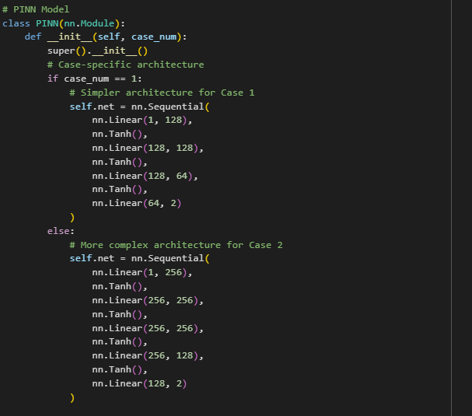

The Model Architecture

Slide 23
FEATURE 2: XAVIER (GLOROT) INITIALIZATION
SBEG108 NUMERICAL METHODS IN BME
What I changed:
Added Xavier initialization for all linear layers.
Benefit:
The model starts training with more balanced weights, leading to faster and more stable convergence.
Why?
Default initialization can cause vanishing or exploding gradients, especially in deep networks.
Xavier initialization keeps the scale of gradients roughly the same across all layers, improving training stability.

Slide 24
SBEG108 NUMERICAL METHODS IN BME
FEATURE 3: GRADIENT CLIPPING
What I changed:
Added gradient clipping
(with different thresholds for each case).
Benefit:
Training remains stable even for challenging cases, and the optimizer can use larger learning rates safely.
Why?
In deep or stiff systems, gradients can become extremely large, causing unstable updates (exploding gradients).
Gradient clipping limits the maximum allowed gradient norm, preventing instability.

Slide 25
FEATURE 4: CURRICULUM LEARNING (FOR COMPLEX CASE)
SBEG108 NUMERICAL METHODS IN BME
What I changed:
For the hard case, trained the model on small time intervals first, then gradually increased the interval.
Benefit:
Faster, more reliable convergence for the complex scenario; avoids poor local minima.
Why?
Learning the full complex problem at once is hard; starting with easier subproblems helps the network learn basic patterns first.
Mimics how humans learn complex tasks step by step.

Slide 26


SBEG108 NUMERICAL METHODS IN BME
Results

Slide 27
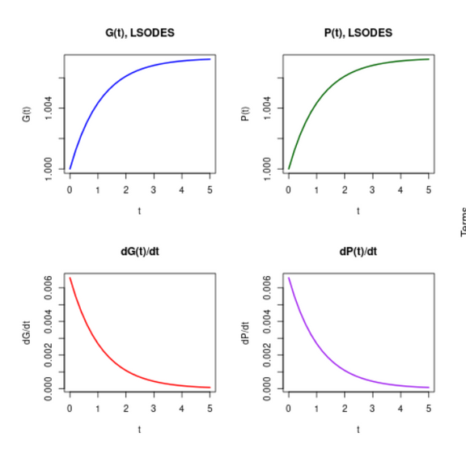
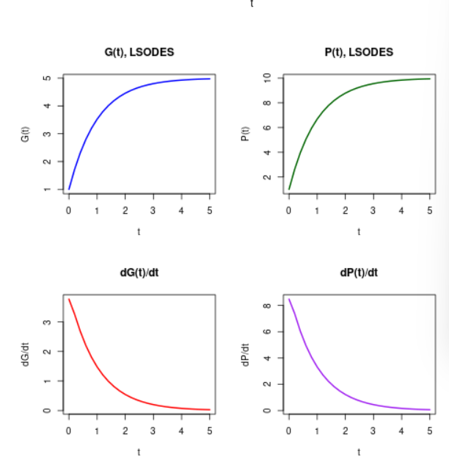
Using deSolve Package (Base Case)
SBEG108 NUMERICAL METHODS IN BME
Chapter Method
Case 1 (Symmetric) Results:
Time | G(t) | P(t) | dG/dt | dP/dt
0.00 | 1.000 | 1.000 | 0.007 | 0.007
1.00 | 1.004 | 1.004 | 0.003 | 0.003
3.00 | 1.007 | 1.007 | 0.000 | 0.000
5.00 | 1.007 | 1.007 | 0.000 | 0.000
Case 2 (Asymmetric) Results:
Time | G(t) | P(t) | dG/dt | dP/dt
0.00 | 1.000 | 1.000 | 3.771 | 8.477
1.00 | 3.521 | 6.685 | 1.480 | 3.318
3.00 | 4.801 | 9.553 | 0.200 | 0.449
5.00 | 4.974 | 9.941 | 0.027 | 0.061

Slide 28
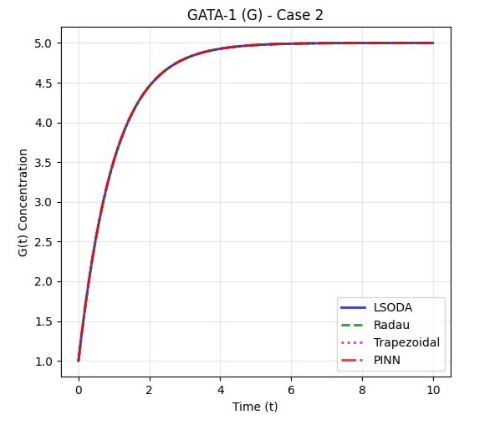
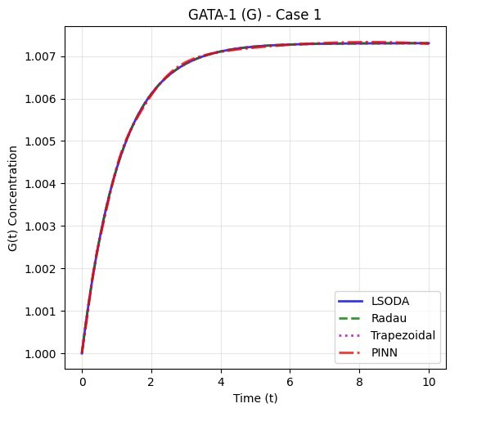
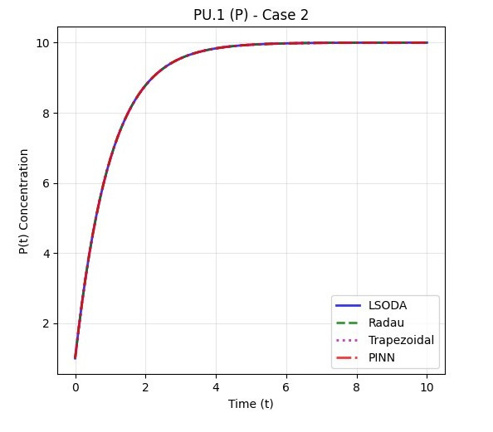
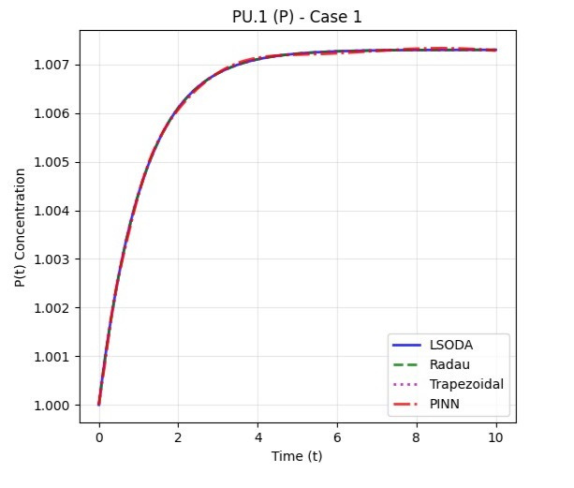
SBEG108 NUMERICAL METHODS IN BME
Demonstrations and results of solutions
Case 1 – Symmetric Results
Numerical Methods:
All methods converge quickly to steady state.
G(t), P(t) remain nearly constant.
PINNs:
Learns flat solution with very low loss.
Interpretation: Cells remain undifferentiated – minimal dynamic activity.
Case 2 – Asymmetric Results
Numerical Methods:
Accurate capture of stiff dynamics.
Handles well but less precise.
PINNs:
Slower convergence, but captured overall trends.
Grows rapidly early on, then stabilizes.

Slide 29

RESULTS
SBEG108 NUMERICAL METHODS IN BME
To evaluate the reliability and effectiveness of different solution technique, we performed a comparative analysis between the three approaches.
For each method, we computed several error metrics for the variables
G(t) and P(t) across the time domain, including:
MSE
(MeanSquared Error)
MAE
(Mean Absolute Error)
R²score
indicating goodness of fit

Slide 30
RESULTS
SBEG108 NUMERICAL METHODS IN BME
Accuracy of G(t) – Case 1 (Symmetric):
Accuracy of G(t) – Case 2 (Asymmetric):
Method | MSE | MAE | R²
Radau | 2.74 × 10⁻¹⁴ | 0.0000 | 1.0000
Trapzoidal | 8.00 × 10⁻¹⁴ | 0.0000 | 1.0000
PINN | 7.26 × 10⁻¹⁰ | 0.0000 | 0.9996
Method | MSE | MAE | R²
Radau | 2.32 × 10⁻¹⁴ | 0.0000 | 1.0000
Trapzoidal | 1.14 × 10⁻⁸ | 0.0001 | 1.0000
PINN | 4.70 × 10⁻⁸ | 0.0001 | 0.9996
Accuracy of P(t) – Case 1 (Symmetric):
Accuracy of P(t) – Case 2 (Asymmetric):
Method | MSE | MAE | R²
Radau | 2.74 × 10⁻¹⁴ | 0.0000 | 1.0000
Trapzoidal | 8.00 × 10⁻¹⁴ | 0.0000 | 1.0000
PINN | 9.24 × 10⁻¹⁰ | 0.0000 | 0.9996
Method | MSE | MAE | R²
Radau | 1.29 × 10⁻¹³ | 0.0000 | 1.0000
Trapzoidal | 4.10 × 10⁻⁷ | 0.0002 | 1.0000
PINN | 5.90 × 10⁻⁷ | 0.0004 | 0.9996
Accuracy of P(t) – Case 2 : This table confirms the trend seen with G(t) in Case 2. All methods remain stable, but slight error differences emerge.
Accuracy of P(t) – Case 1 : As with G(t), the predictions for P(t) are highly accurate across all methods.

Slide 31

Computational Performance:
As expected, traditional numerical solvers complete in milliseconds to seconds. PINNs, which require intensive training and optimization, are significantly slower, limiting their use in real-time applications.
COMPUTATION
TIME
CASE | METHOD | TIME
1 | LSODES RADAU TRAPEZOIDAL PINN | 0.0022 0.0519 0.0037 0.00056(197.73)
2 | LSODES RADAU TRAPEZOIDAL PINN | 0.0033 0.0519 0.0062 0.0006(370.63)
Training Time
Note:
For the PINNs : 197.73 is the total of training and testing time
0.00056 is the testing time

Slide 32
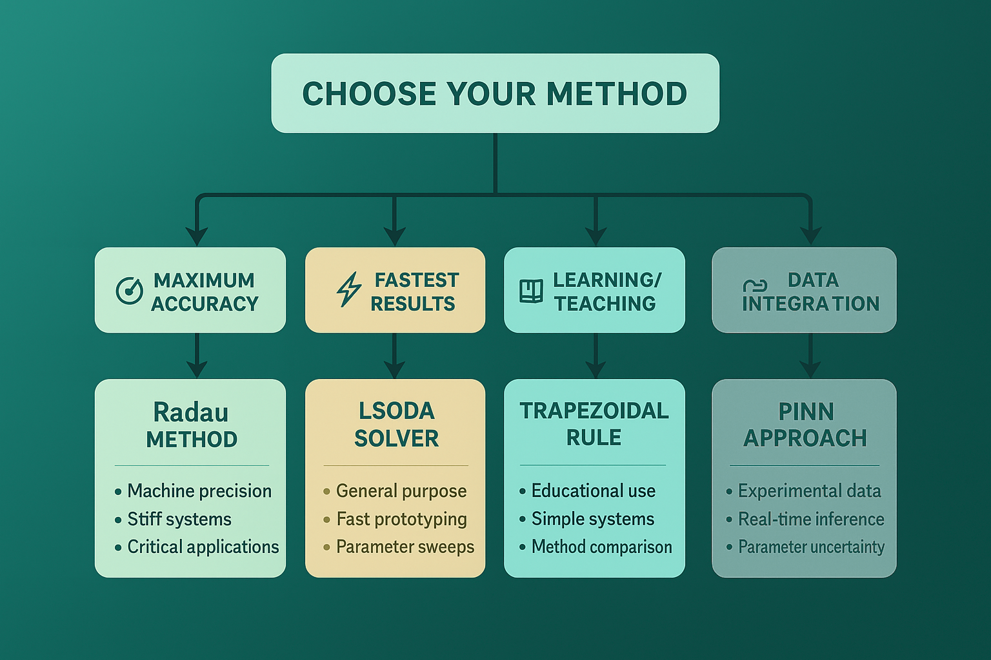
SBEG108 NUMERICAL METHODS
IN BME
lSODEs
To Conclude

Slide 33
SBEG108 NUMERICAL METHODS IN BME
Future Work and Improvements

Slide 34


SBEG108 NUMERICAL METHODS IN BME
Using simpler architecture
that can reduce parameter sensitivity
Transfer Learning:
Leveraging pretrained models on similar systems
Adaptive Time Stepping:
Incorporate dynamic step size control based on
local error estimation to enhance efficiency and stability.
How Can we improve the the model, methods, and results
Adaptive Sampling:
Selecting collocation points based on solution gradients

Slide 35

Survey of Work on Stem Cell Modeling
References:
[1] S. Huang, Y.-P. Guo, G. May, and T. Enver,
“Bifurcation dynamics in lineage-commitment in bipotent progenitor cells,”
Exp. Hematol., vol. 35, no. 11, pp. 1707–1718, Nov. 2007.
[2] C. Duff, K. Smith-Miles, L. Lopes, and T. Tian,
“Mathematical modelling of stem cell differentiation: The PU.1–GATA-1 interaction,”
BMC Systems Biology, vol. 6, no. 1, 2012.
[3] T. Tian et al.,
“Mathematical modeling of GATA-switching for regulating the differentiation of hematopoietic stem cells,”
BMC Bioinformatics, vol. 9, Suppl 9, 2008.
[4] G. E. Karniadakis, I. G. Kevrekidis, L. Lu, P. Perdikaris, S. Wang, and L. Yang,
“Physics-informed machine learning,”
Nature Reviews Physics, vol. 3, no. 6, pp. 422–440, Jun. 2021.
Tools:
R – deSolve Package
PyTorch – PINNs Implementation

Slide 36
Thanks for Listening

